Slide 1

Rockbuster StealtH: Analysis
Achieving Success in the Online Video Rental Market

Slide 2
Rockbuster Stealth
Rockbuster Stealth is facing new challenges as the landscape of movie rentals continues to evolve rapidly in recent years.
Our goal is to analyse the available data to identify strategies that will help us remain competitive in this dynamic market. By studying customer habits and current revenue patterns, we aim to develop targeted recommendations to improve customer retention and loyalty.
Additionally, we will explore opportunities for growth to adapt to changing consumer preferences and strengthen our market position for the future.

Slide 3
Content
Summary Statistics
Highest and Lowest Revenue
Rental Rate
Customer Location and Revenue Impact
Recommendations

Slide 4
Summary Statistics
Minimum Rental Price – 0,99€
Maximum Rental Price – 4,99€
Average Rental Price – 2,98€
Total Inventory - 4581
Minimum Rental Duration – 3 Days
Maximum Rental Duration – 7 Days
Average Rental Duration – 5 Days
Number of Customer – 599
Number of Rentals - 16044
Although Rockbuster operates on a relatively small scale in terms of inventory and customer base, our customers demonstrate a high level of engagement with approximately 27 rentals annually per customer. Additionally, customers tend to rent films for an average of 5 days, reflecting consistent and extended viewing periods despite our limited size. This active rental behaviour highlights the strong loyalty and demand among our customer base.

Slide 5
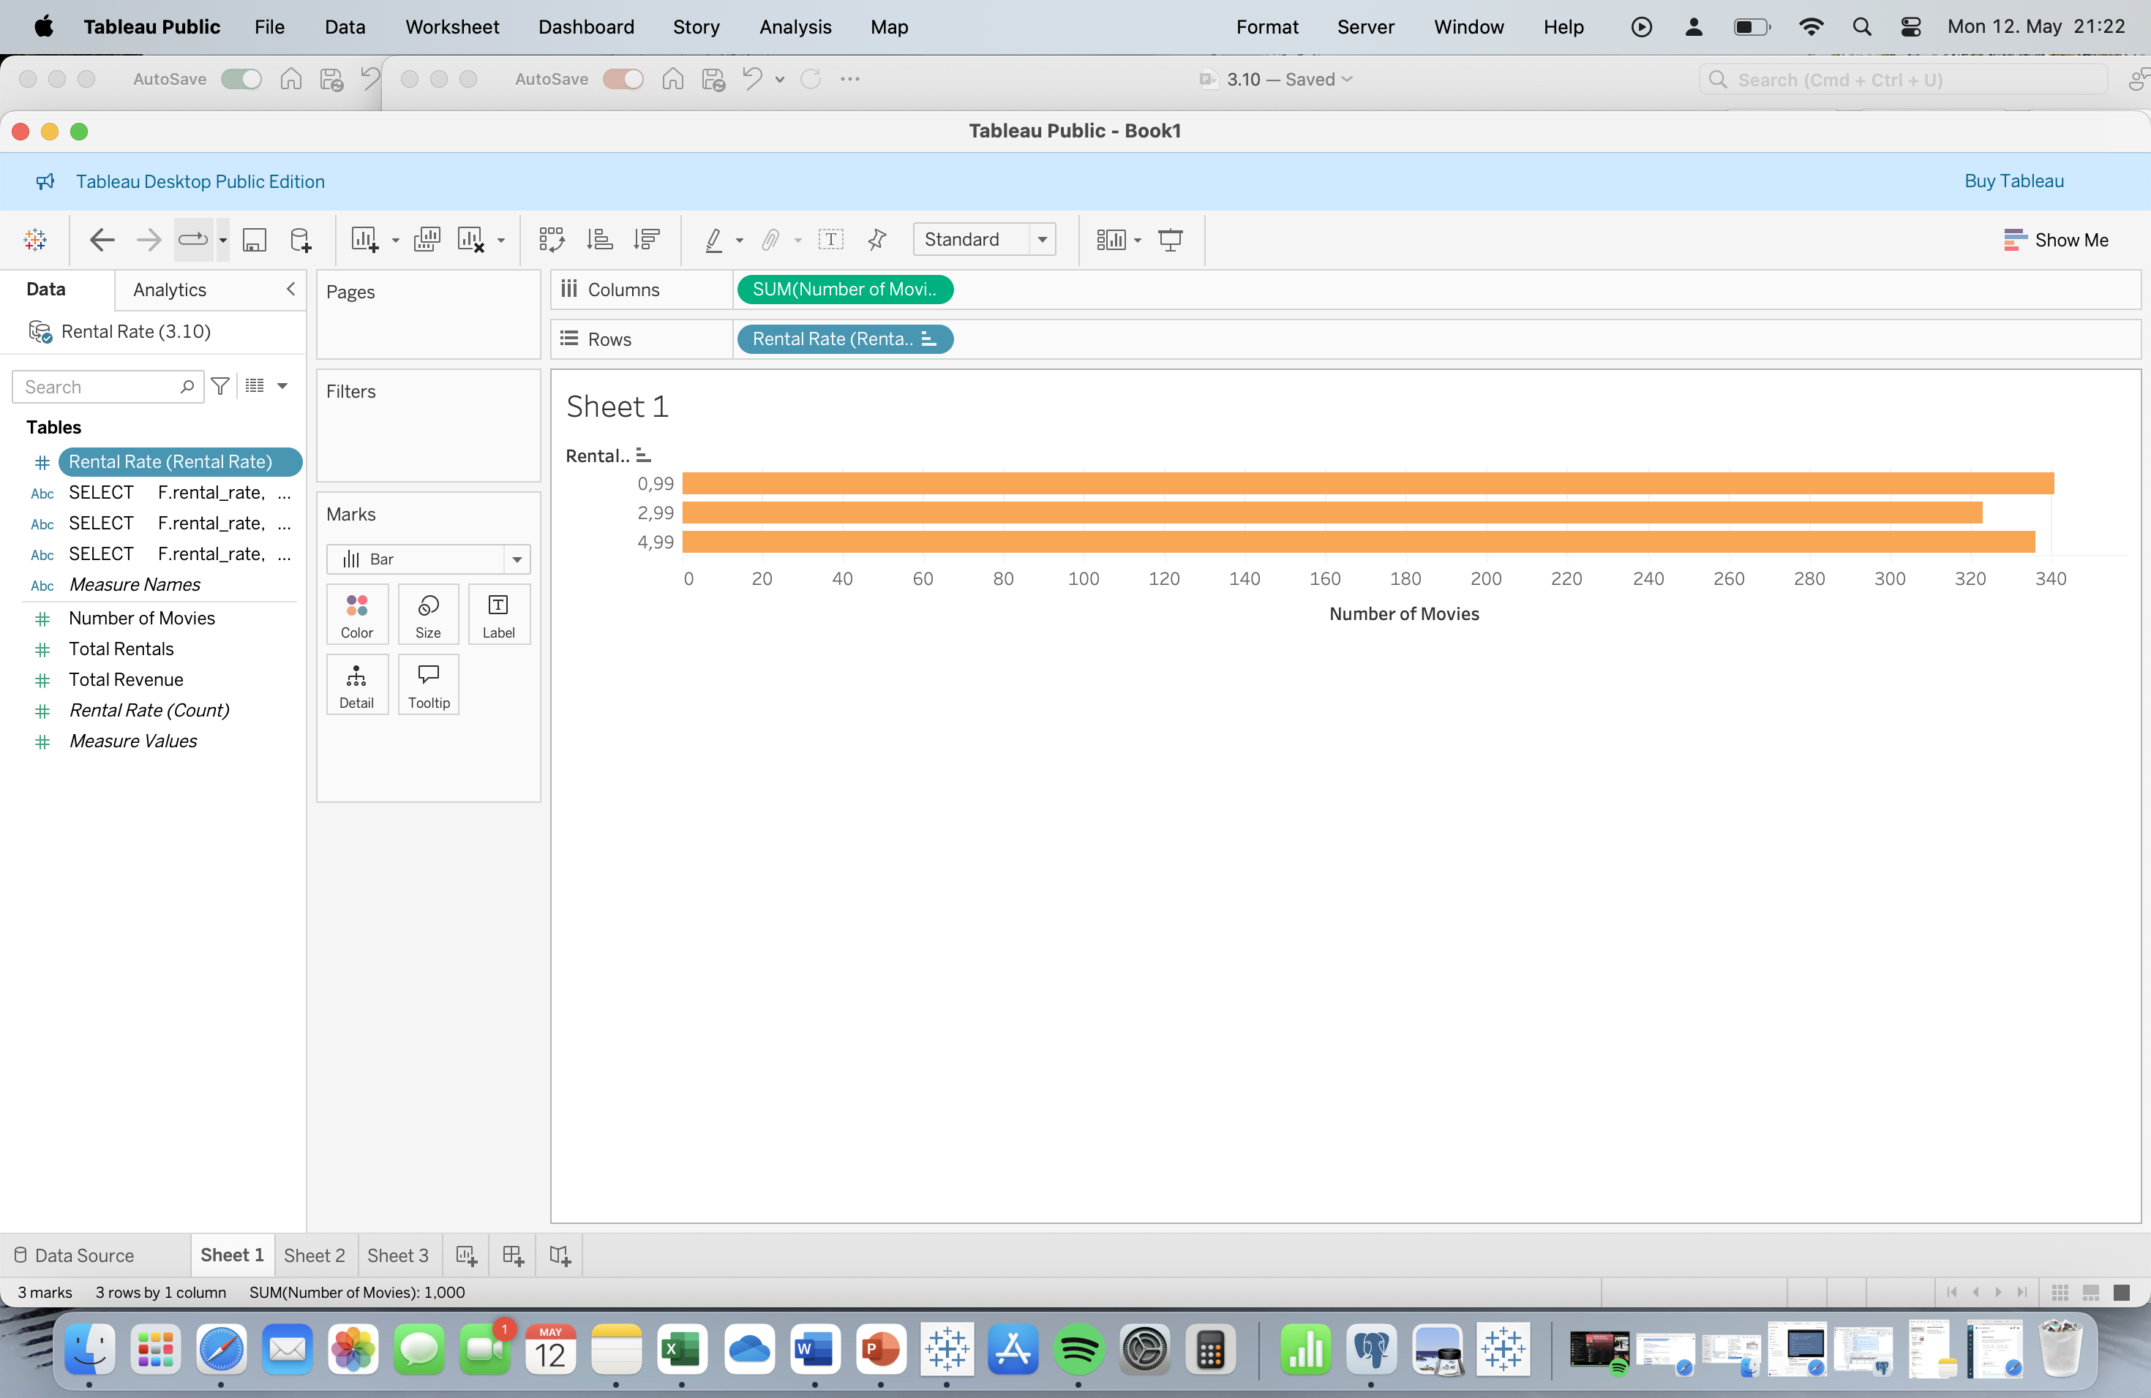
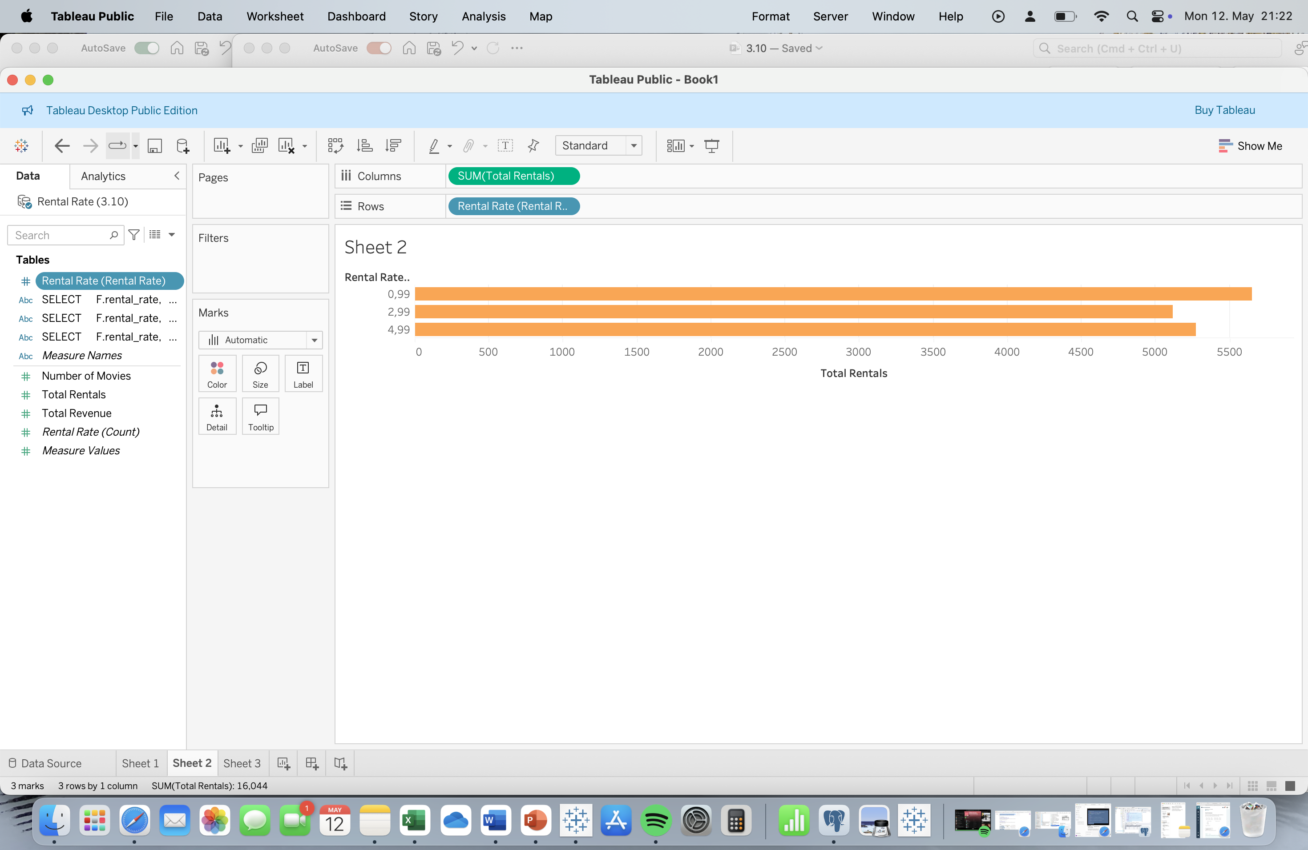
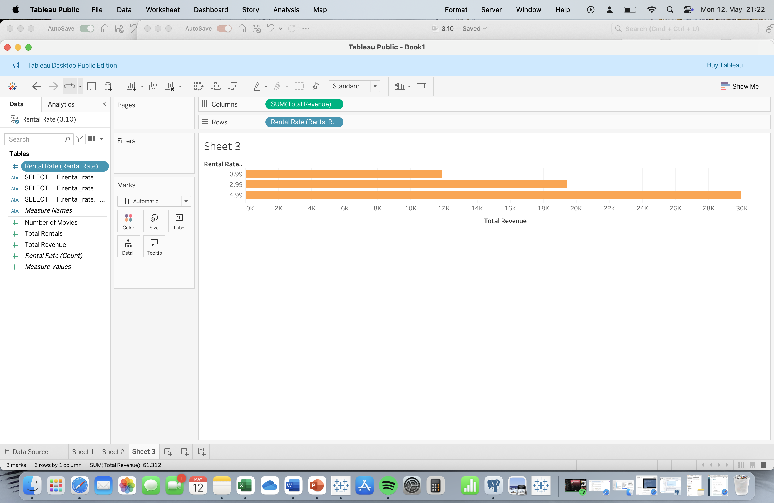
Rental Rate
Rockbuster offers three film rental price points: 0,99€, 2,99€, and 4,99€.
While the inventory levels for each price category are similar, the 0,99€ rate accounts for the highest number of rentals. However, despite its popularity, the 0,99€ rentals generate less than half of the total revenue.
The graph shows little demand difference between the price points, indicating price isn't the main factor in customer choice. However, the chosen price greatly affects total revenue.
Adjusting the prices, such as increasing the 0,99€ rate by 0,50€, could significantly boost revenue without a drastic change in customer behaviour. This strategy could help improve profitability while maintaining customer interest.

Slide 6
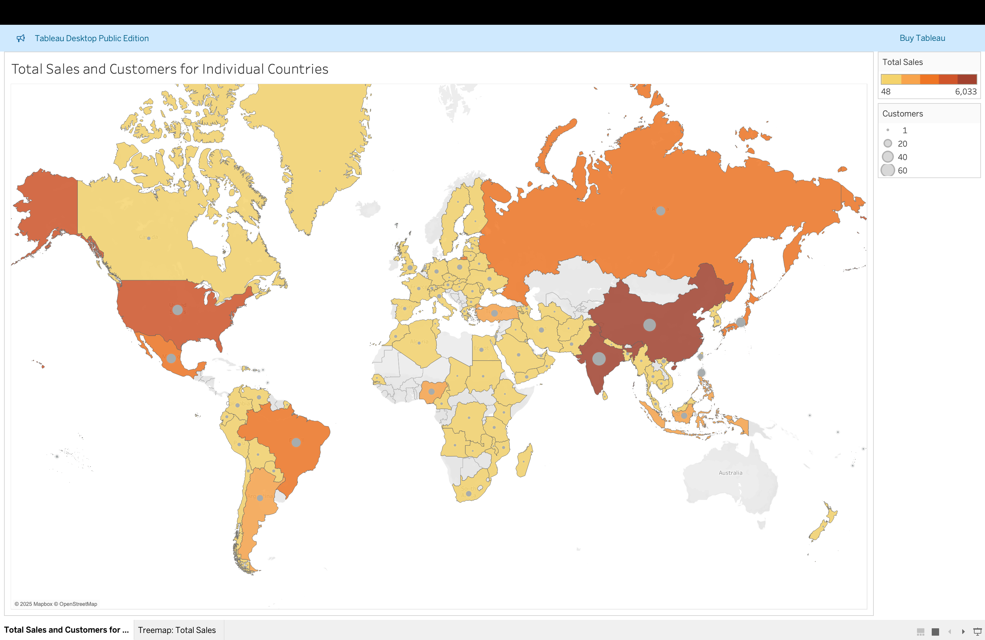
Customer Location and Revenue Impact
Rockbuster’s customer count directly influences sales across regions. India leads with 60 customers and €6,032.79 in sales, with each customer renting 23 films annually showing strong engagement.
The data also indicates substantial variability in sales figures across geographic regions, underscoring the importance of regional strategies to maximize customer engagement and sales growth. This engagement from existing customers, such as in the table, showcases significant potential for expansion and targeting in high-performing regions.
Country: China
Customers: 53
Total Sales: 5247,04€
Total Rentals: 1296
Country: United States
Customers: 36
Total Sales: 3694,27€
Total Rentals: 873
Country: India
Customers: 60
Total Sales: 6032,79€
Total Rentals: 1421
Top 5 Customers in the Top Countries
Darker colours = Higher Revenue,
Larger Circles = Higher Customer Amounts
Customer ID | First Name | Last Name | City | Country | Total Amount Paid
225 | Arlene | Harvey | Ambattur | India | 111,76
424 | Kyle | Spurlock | Shanwei | China | 109,71
240 | Marlene | Welch | Iwaki | Japan | 106,77
486 | Glen | Talbert | Acua | Mexico | 100,77
537 | Clinton | Buford | Aurora | United States | 98,76

Slide 7
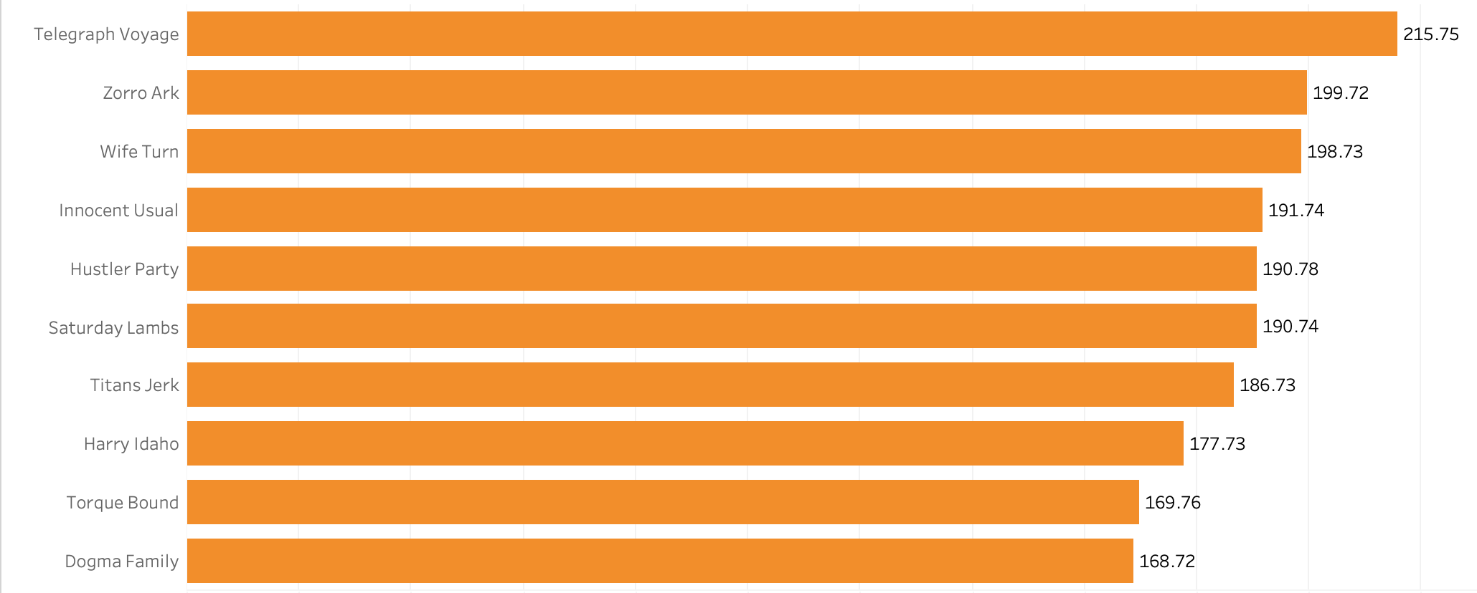
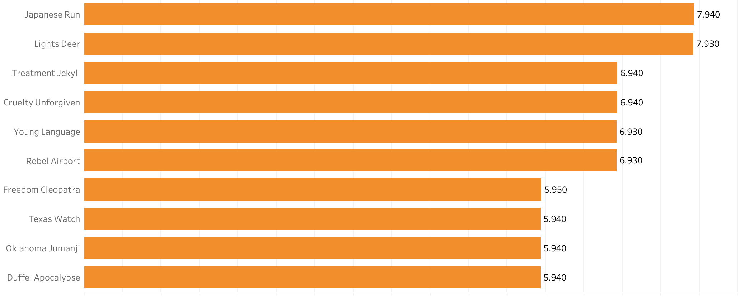
The Movies Driving the Highest and Lowest Revenue?
Movies with the Highest Revenue
The top 10 movies account for only 1890,4€ of Rockbuster's total revenue, indicating that revenue is distributed across a wide range of films. To boost overall sales, we should consider expanding our inventory to include more titles, thereby increasing potential revenue growth.
Movies with the Lowest Revenue
While the lowest-earning movies generate only 5,94€, a closer look reveals that these three titles are all priced at 0,99€ and have been rented 6 times. In contrast, the more frequently rented movie in this group have been rented 29 times. This suggests that increasing the 0,99€ price point could be a strategic move to boost revenue.

Slide 8
Recommendations
Promote longer rentals, as the average duration is around 5 days, indicating a strong customer preference for extended viewing periods.
Consider increasing the €0.99 price point for selected titles to enhance profit margins, especially for titles with consistent rental activity.
Implementing a loyalty program to capitalise on the high engagement of existing customers, encouraging repeat business and boosting customer retention.
Expand the inventory to diversify offerings, attract new customers, and support revenue growth by meeting increasing demand for a wider selection of titles.

Slide 9
Thank you
Any questions or suggestions?
If you have questions later please contact me

